Slide 1
Radix Sort
Represents keys as d-digit numbers in some base-k
key = x₁x₂...x_{d} where 0≤x_{i}≤k-1
Example: key=15
key₁₀ = 15, d=2, k=10 where 0≤x_{i}≤9
key₂ = 1111, d=4, k=2 where 0≤x_{i}≤1

Slide 2

Radix Sort
Assumptions
  d=O(1) and k =O(n)
Sorting looks at one column at a time
  For a d digit number, sort the least significant digit first
  Continue sorting on the next least significant digit, until all digits have been sorted
  Requires only d passes through the list

Slide 3

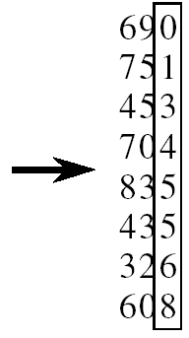
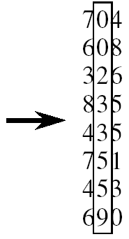
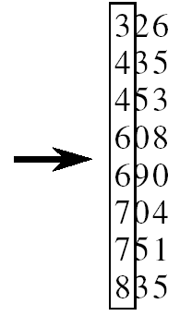
RADIX-SORT
Alg.: RADIX-SORT(A, d)
for i ← 1 to d
do use a stable sort to sort array A on digit i
(stable sort: preserves order of identical elements)

Slide 4
Analysis of Radix Sort
Given n numbers of d digits each, where each digit may take up to k possible values, RADIX-SORT correctly sorts the numbers in O(d(n+k))
  One pass of sorting per digit takes O(n+k) assuming that we use counting sort
  There are d passes (for each digit)

Slide 5
Analysis of Radix Sort
Given n numbers of d digits each, where each digit may take up to k possible values, RADIX-SORT correctly sorts the numbers in O(d(n+k))
  Assuming d=O(1) and k=O(n), running time is O(n)

Slide 6
Bucket Sort
Assumption:
  the input is generated by a random process that distributes elements uniformly over [0, 1)
Idea:
  Divide [0, 1) into k equal-sized buckets (k=Θ(n))
  Distribute the n input values into the buckets
  Sort each bucket (e.g., using quicksort)
  Go through the buckets in order, listing elements in each one
Input: A[1 . . n], where 0 ≤ A[i] < 1 for all i
Output: elements A[i] sorted

Slide 7
Example - Bucket Sort
A
1
.78
.17
.39
.26
.72
.94
.21
.12
.23
.68
B
0
/
2
1
.17
.12 /
3
2
.26
.21
.23 /
4
3
.39 /
5
4
/
Distribute
Into buckets
6
5
/
7
6
.68 /
8
7
.78
.72 /
9
8
/
10
9
.94 /

Slide 8
Example - Bucket Sort
0
/
1
.12
.17 /
2
.21
.23
.26 /
3
.39 /
Sort within each
bucket
4
/
5
/
6
.68 /
7
.72
.78 /
8
/
9
.94 /

Slide 9
Example - Bucket Sort
.12
.17
.21
.23
.26
.39
.68
.72
.78
.94 /
0
/
1
.12
.17 /
2
.21
.23
.26 /
3
.39 /
4
/
5
/
Concatenate the lists from
0 to n – 1 together, in order
6
.68 /
7
.72
.78 /
8
/
9
.94 /

Slide 10
Analysis of Bucket Sort
Alg.: BUCKET-SORT(A, n)
for i ← 1 to n
do insert A[i] into list B[⎣nA[i]⎦]
for i ← 0 to k - 1
do sort list B[i] with quicksort sort
concatenate lists B[0], B[1], . . . , B[n -1] together in order
return the concatenated lists
O(n)
k O(n/k log(n/k))
=O(nlog(n/k)
O(k)
O(n) (if k=Θ(n))

Slide 11
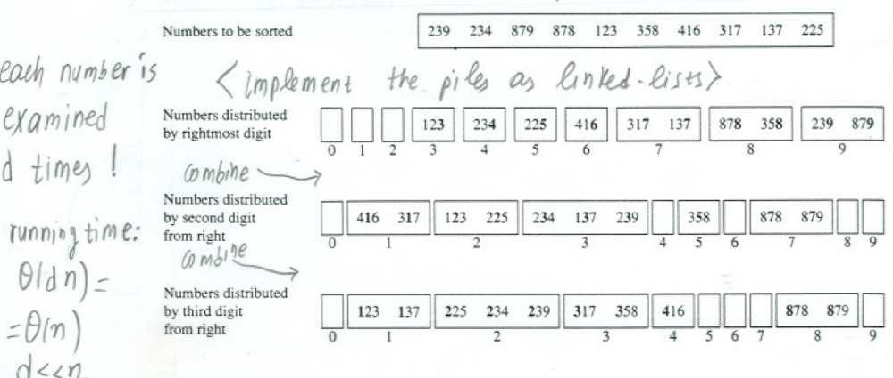
Radix Sort as a Bucket Sort

